Slide 1


Minor Project
Title:
Network Packet Sniffer
Presented by:
Divyansh Kumar, R2142201372, 500084995, CSE CSF ( HONS )
Priyal Khurana, R214220870, 500082568, CSE CSF ( NON-HONS)
Mitali Chaudhary, R214220704, 500084412, CSE CSF(NON-HONS)
Guided by:
Dr. Akashdeep Bhardwaj
Professor
School of Computer Science

Slide 2
Content
Introduction
Problem Statement
Motivation
Objectives
Tech Stack
Methodology
Implementation
SWOT Analysis
PERT Chart
Objectives Covered
References

Slide 3
Introduction
Network Packet Sniffer or Intrusion Detector System is a system for detecting intrusions and reporting them accurately to the administrator.
This project aims at developing a Network Packet Sniffer. Network Packet Sniffer is a piece of software that monitors all incoming and outgoing network traffic.
As data streams flow across the network, the sniffer captures each packet and eventually decodes and analyzes its content.
This project will be comprised of three modules namely the User Interface module, Statistics module, and Packet Analysis module.
It performs real-time packet capturing, 24x7 network monitoring, advanced protocol analyzing, in-depth packet decoding and automatic expert diagnosing.
It provides an administrator with a full set of reports such as Summary view, Endpoints view, and Protocols view.

Slide 4
Problem Statement
We have too much outgoing and incoming data while we are on the network and if we study these sniffed data packets we can get to know where all we are sending and what kind of data is being received by us,
If we use it for legitimate purposes we can detect if any malicious act is happening in our system. The aim is to collect this enormous amount of data packets generated to form a crisp report for the administrator to run a check on system.

Slide 5
Motivation
The project aims to have the following features:-
The proposed packet sniffer software makes it easy to identify, diagnose, and solve network problems for IT individuals.
Feasibility – The proposed Network Packet Sniffer Software will work as a network administrator which can monitor the packets anywhere throughout the world.
The main objective of this project shows how network information can be modeled.
Another main objective is to capture incoming and outgoing data.
The system aims to create a new set of rules during run time. So, the intruder cannot be able to attack the system with a virus.

Slide 6
Objectives
To capture all the incoming and outgoing data
To increase feasibility of use to work in IT firms
To perform real packet capturing
To perform network and security monitoring
To create a new set of rules during run time

Slide 7
Technology Stack
Version Control
Github
Software specifications:
Languages/packages: Java, Jnetpcap
JSK version: JDK 1.6.0
Communication Protocol: HTTP Protocol

Slide 8
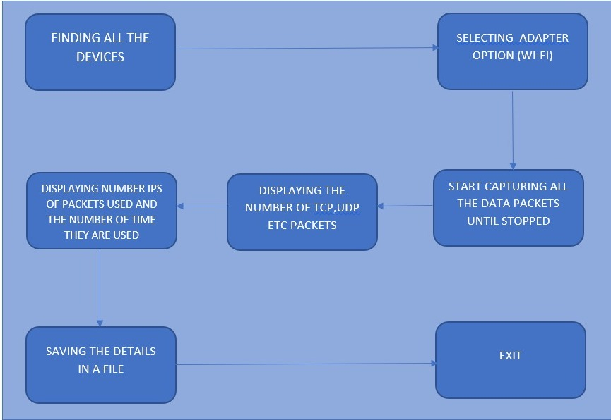
Methodology
6.1 Development Methodology
The project focuses on building a network packet sniffer, which captures all the incoming and outgoing data.

Slide 9

Implementation
OUTPUT:

Slide 10


Slide 11
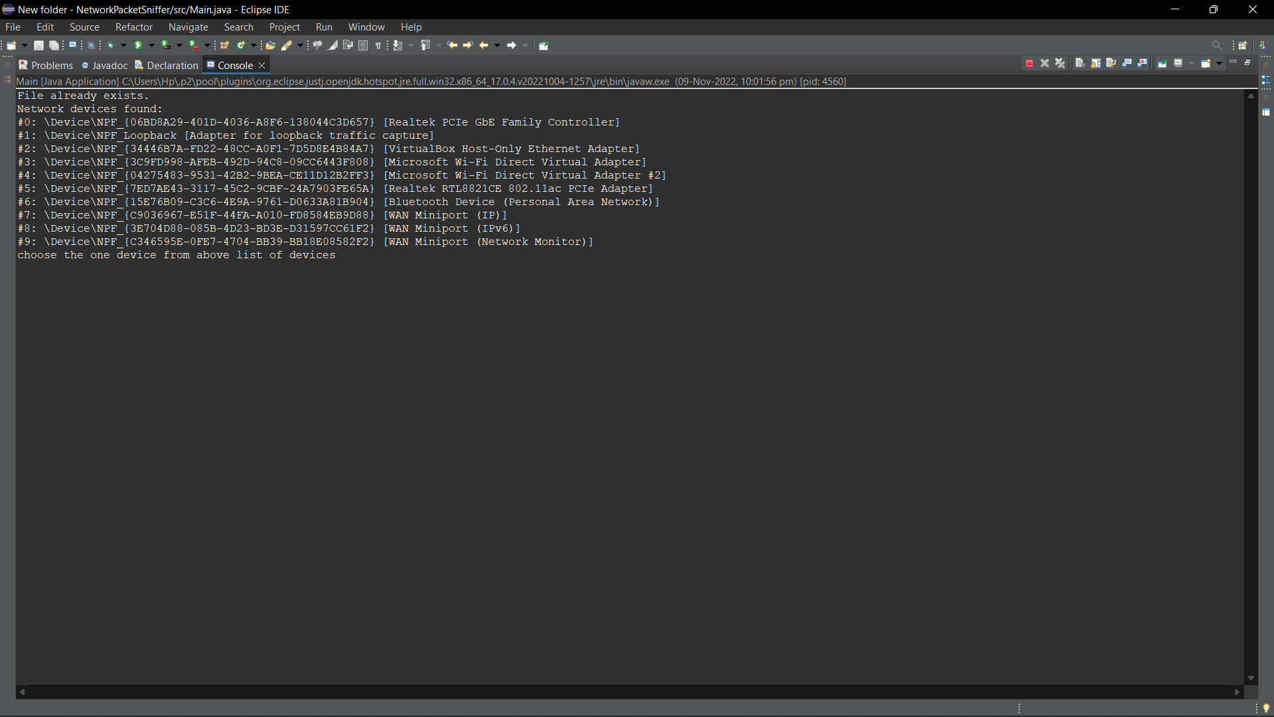

Slide 12
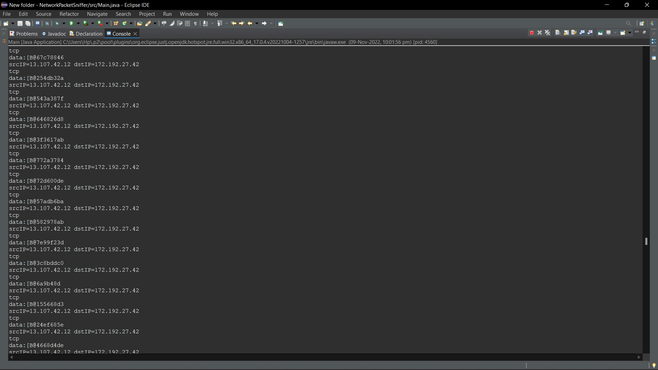

Slide 13
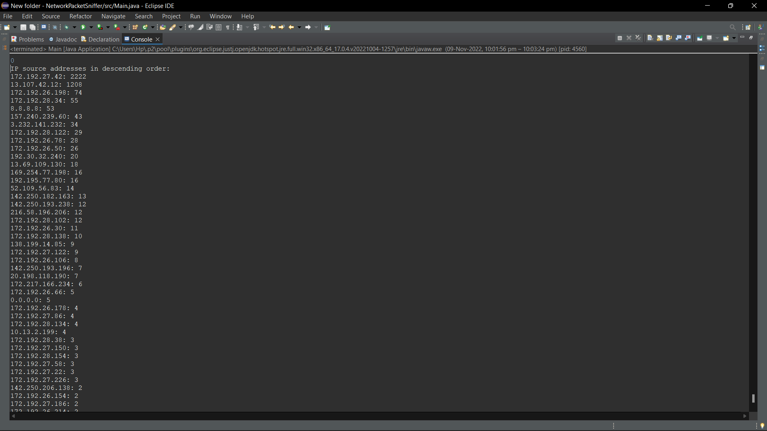

Slide 14
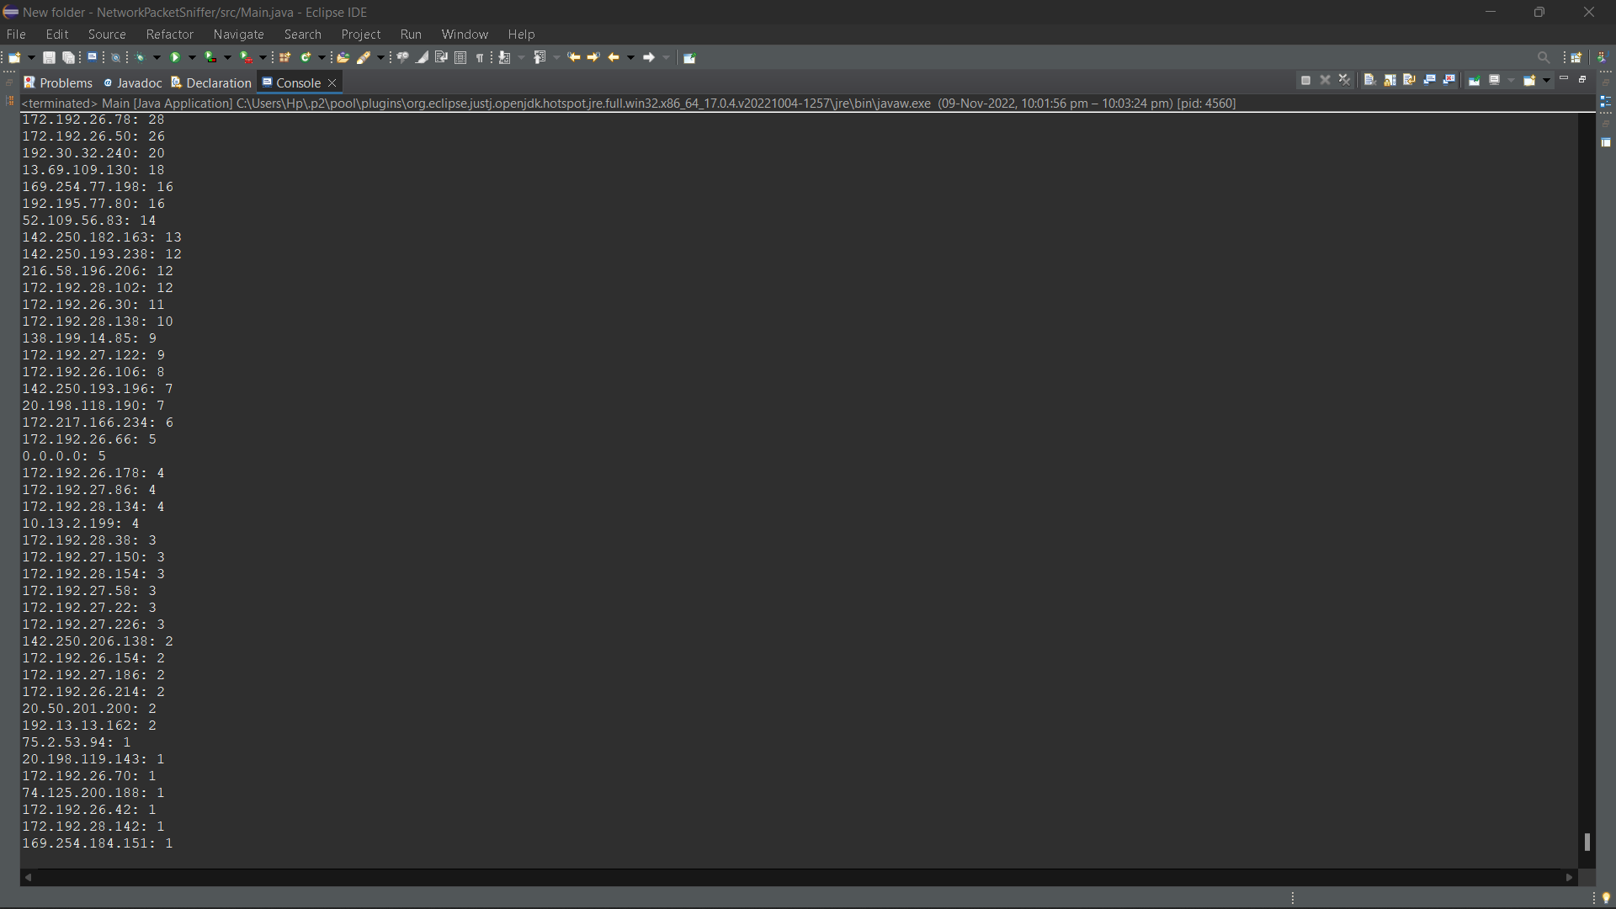

Slide 15
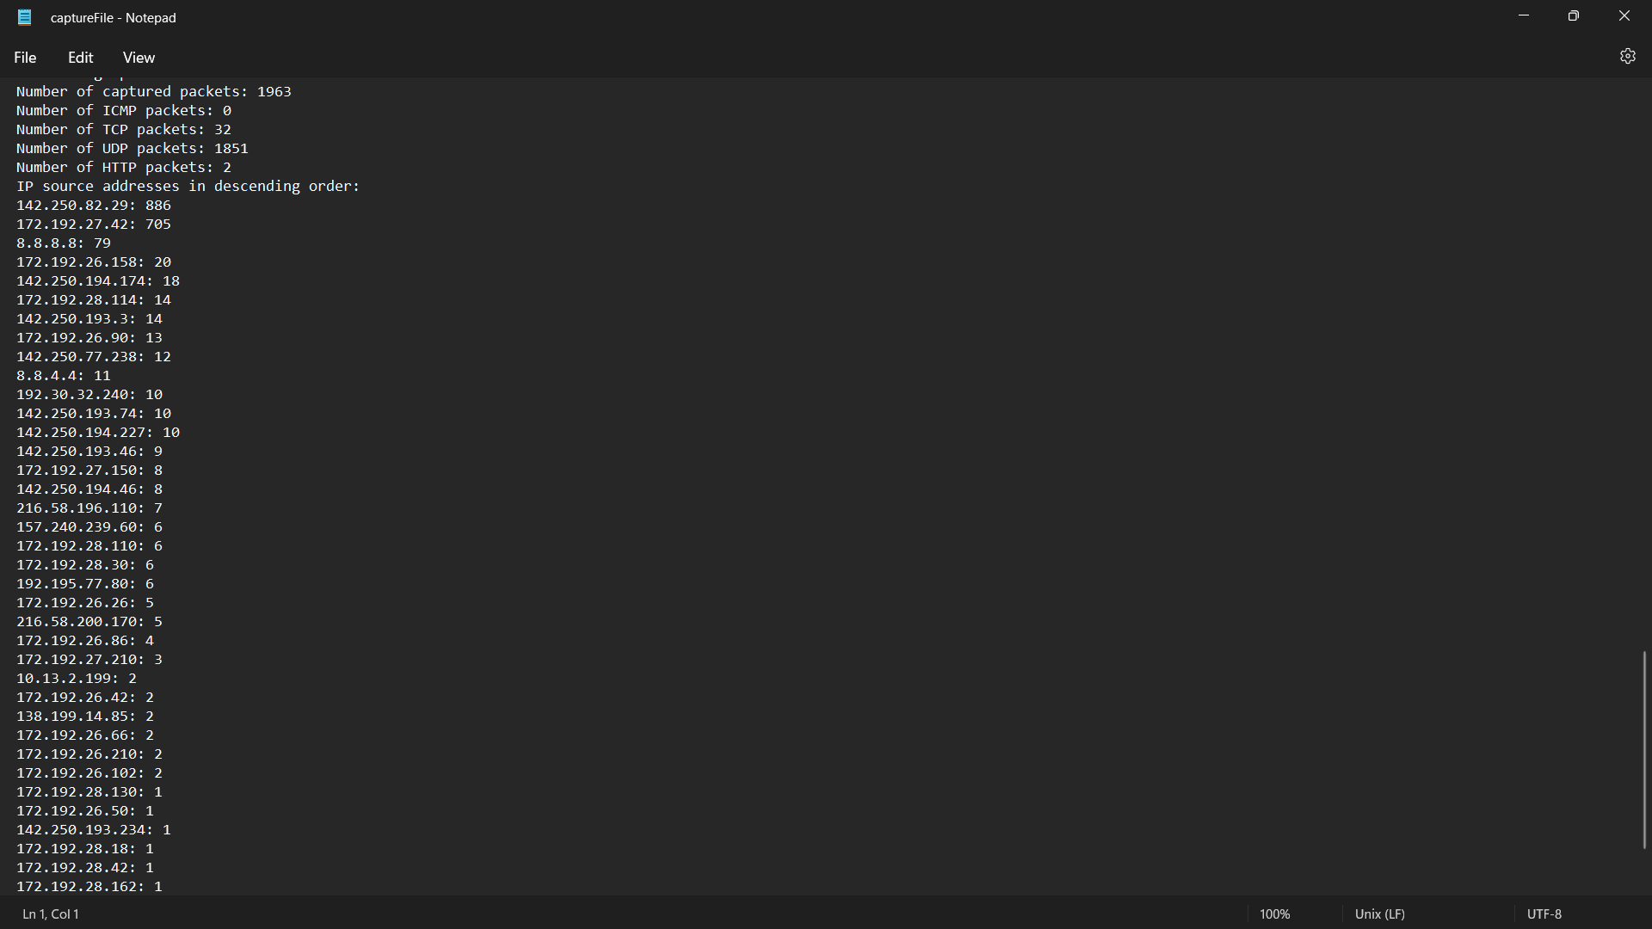

Slide 16
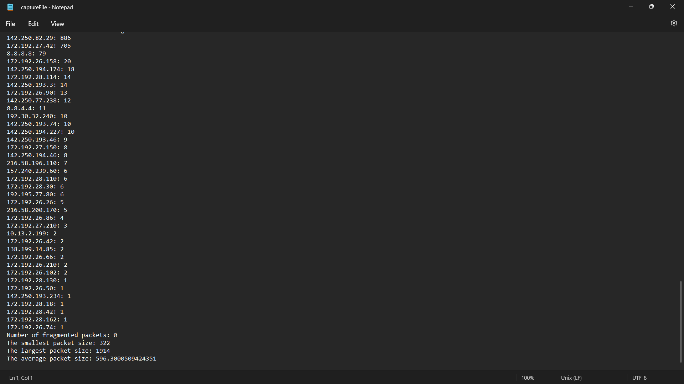

Slide 17
SWOT Analysis
Strength: The proposed project will capture all the incoming and outgoing data without the presence of an administrator by generating alerts if multiple logins or any malicious activity is done
Weakness: There is zero possibility of automatic network control and the presence of an administrator is compulsory, even if there are automatic diagnoses the reports still need to be analyzed by the administrator.
Opportunities: It can have many more modules included in it that will boost its performance and will increase its feasibility of use to work in IT firms. The wide range of valid possibilities that this project can evolve into some bigger network trafficking project or maybe subsume under some higher application which helps in securing the networks. This project can also be used for educational purposes, say, to demonstrate working Wireshark and show the capture of real-time packets.
Threats: Our proposed project network packet sniffer can record any transmitted data and send it to command and control for further analysis. It’s then possible for hackers to attempt packet injection or man-in-the-middle attacks, along with compromising any data that was not encrypted or that was not captured before being sent.

Slide 18
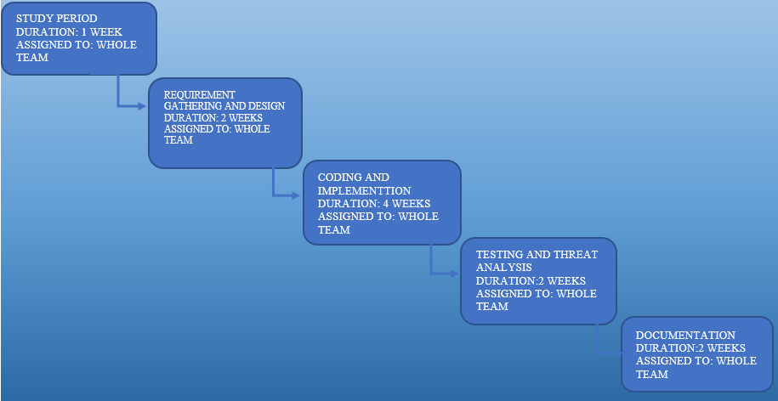
PERT Chart
Fig.6 Program Evaluation Review Technique Chart

Slide 19
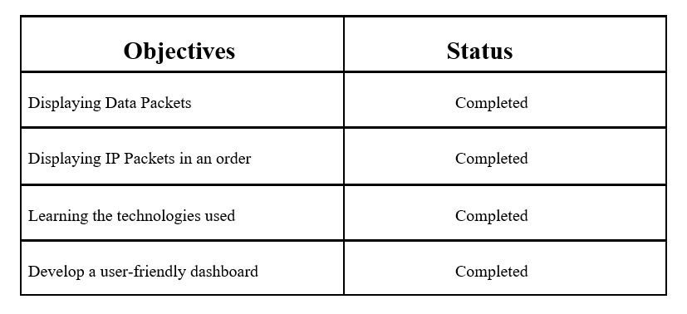
Objectives Covered

Slide 20
References
[1] A. Siswanto, A. Syukur, E. A. Kadir and Suratin, "Network Traffic Monitoring and Analysis Using Packet Sniffer," 2019 International Conference on Advanced Communication Technologies and Networking (CommNet), 2019, pp. 1-4, doi: 10.1109/COMMNET.2019.8742369
[2] J. Xu, S. Gong, Y. Zou, W. Liu, K. Zeng and D. Niyato, "Redundant Sniffer Deployment for Multi-Channel Wireless Network Forensics With Unreliable Conditions," in IEEE Transactions on Cognitive Communications and Networking, vol. 6, no. 1, pp. 394-407, March 2020, doi: 10.1109/TCCN.2019.2937487.
[3] X. Guo, T. Gao, C. Dong, K. Cao, Y. Nan and F. Yu, "A Real-time Network Monitoring Technique for Wireless Sensor Networks," 2022 IEEE 12th International Conference on Electronics Information and Emergency Communication (ICEIEC), 2022, pp. 32-36, doi: 10.1109/ICEIEC54567.2022.9835059
[4] Network Analysis using Wireshark 2 Cookbook: Practical recipes to analyze and secure your network [Online]. Available: https://www.pdfdrive.com/network-analysis-usingwireshark-2-cookbook-practical-recipes-to-analyze-and-secure-your-network-usingwireshark-2-2nd-edition-e184639568.html
[5] Wireshark & ethereal network protocol Analyzer Tool Kit. [Online]. Available: https://www.pdfdrive.com/wireshark-ethereal-network-protocol-analyzer-toolkite158830603.html

Slide 21

Thank You

